Slide 1
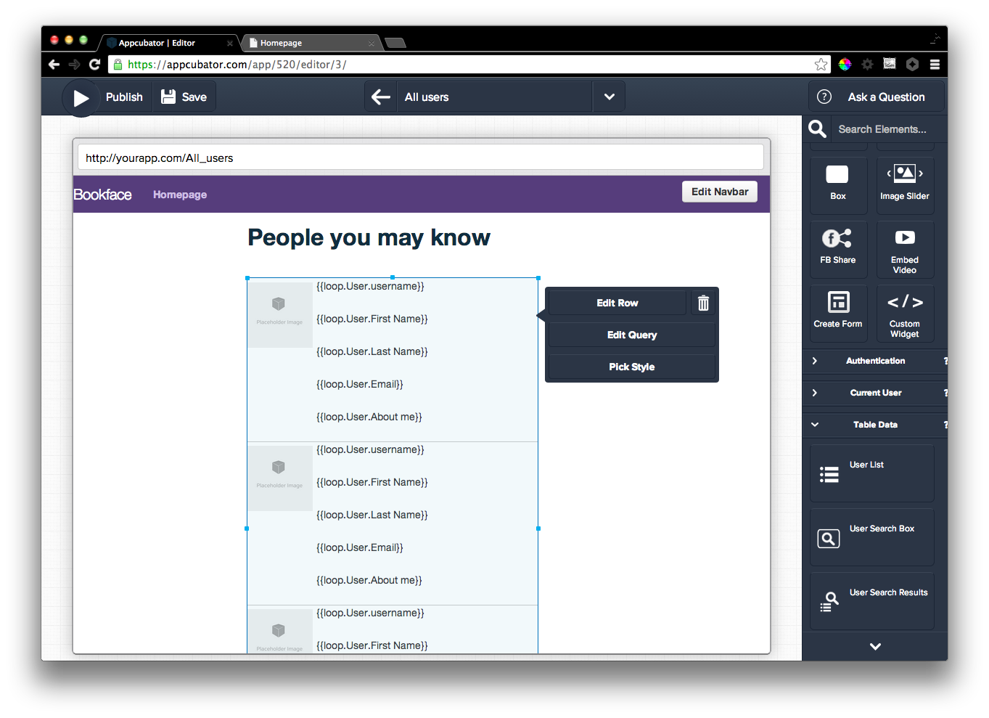
Notes:
New page and drag user list onto the page

Slide 2
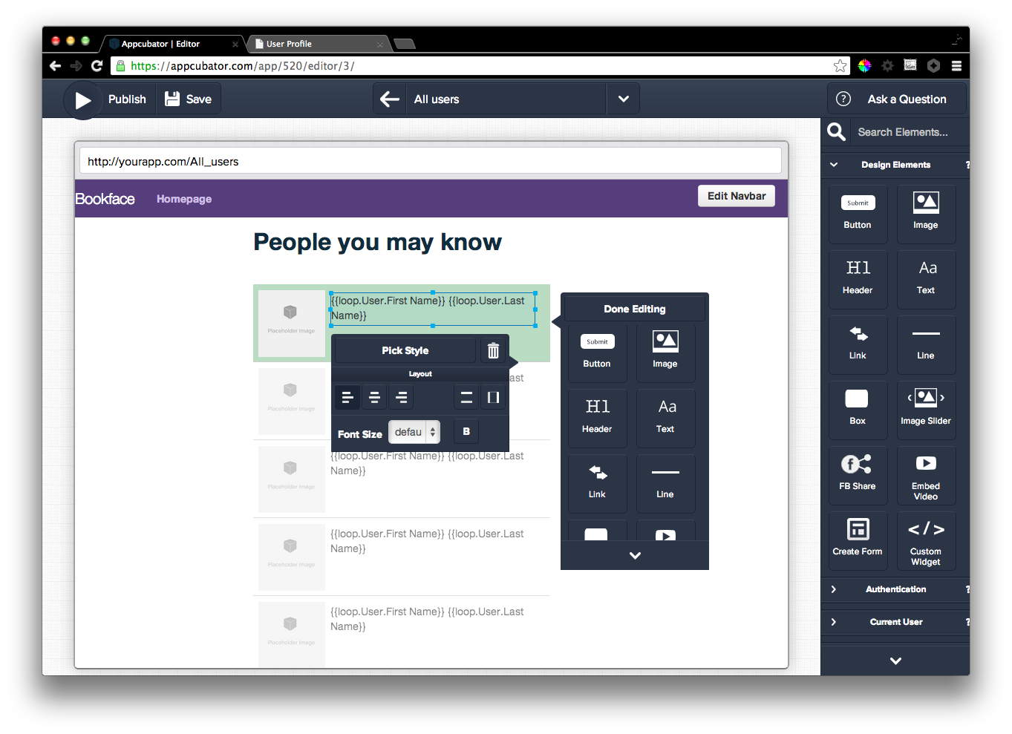
Notes:
Remove text that doesn’t matter,

Slide 3
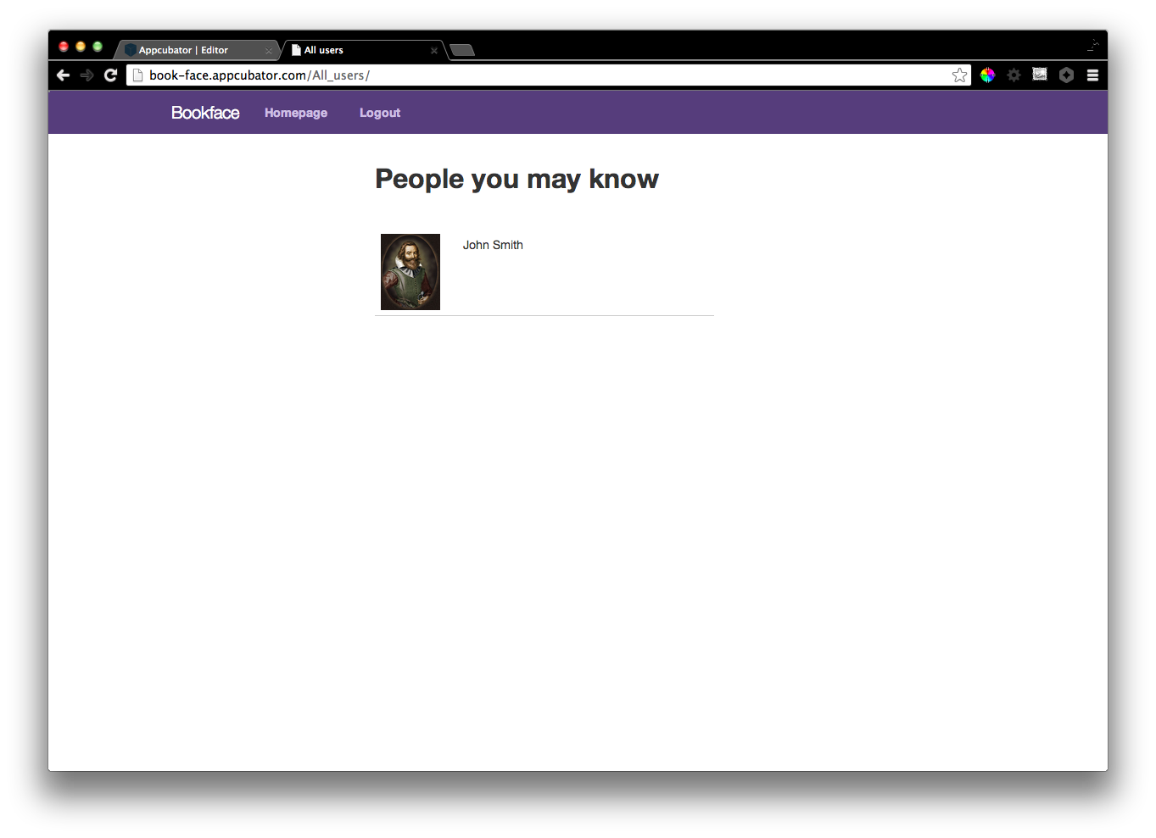
Notes:
Here’s what a sample user on the generated site looks like.

Slide 4
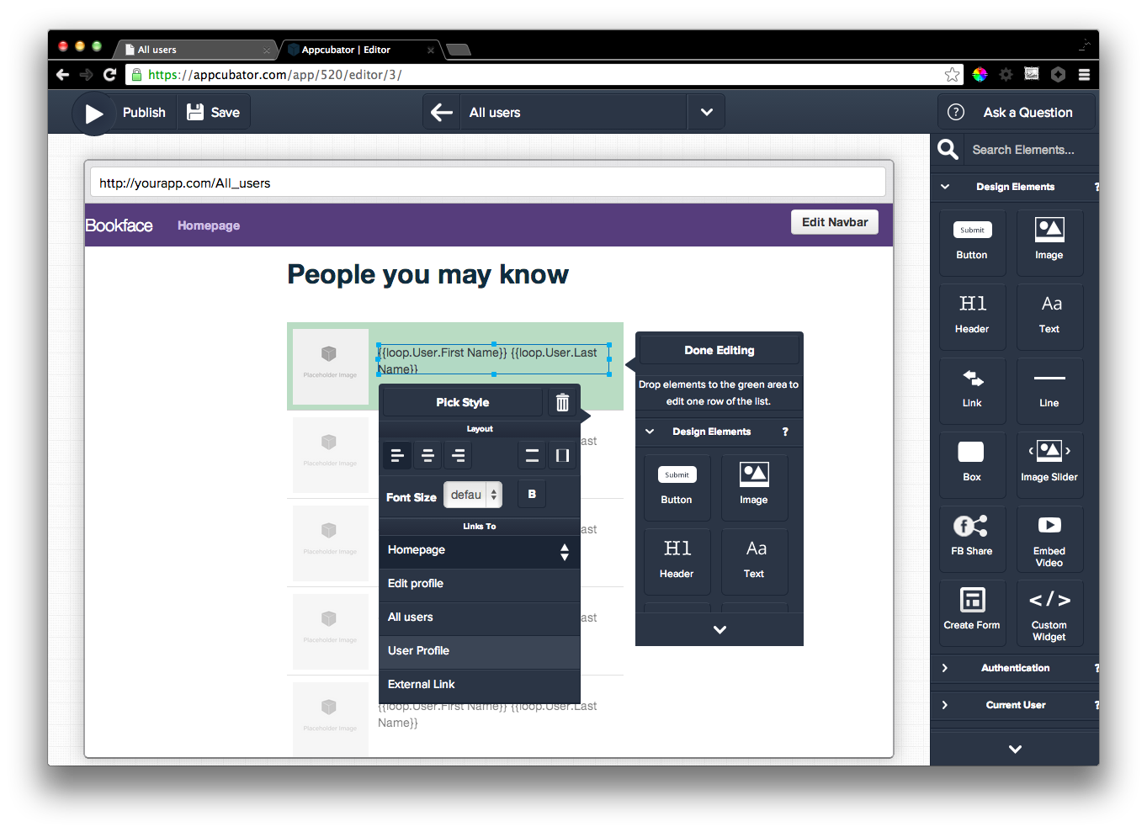
Notes:
Make it a link

Slide 5
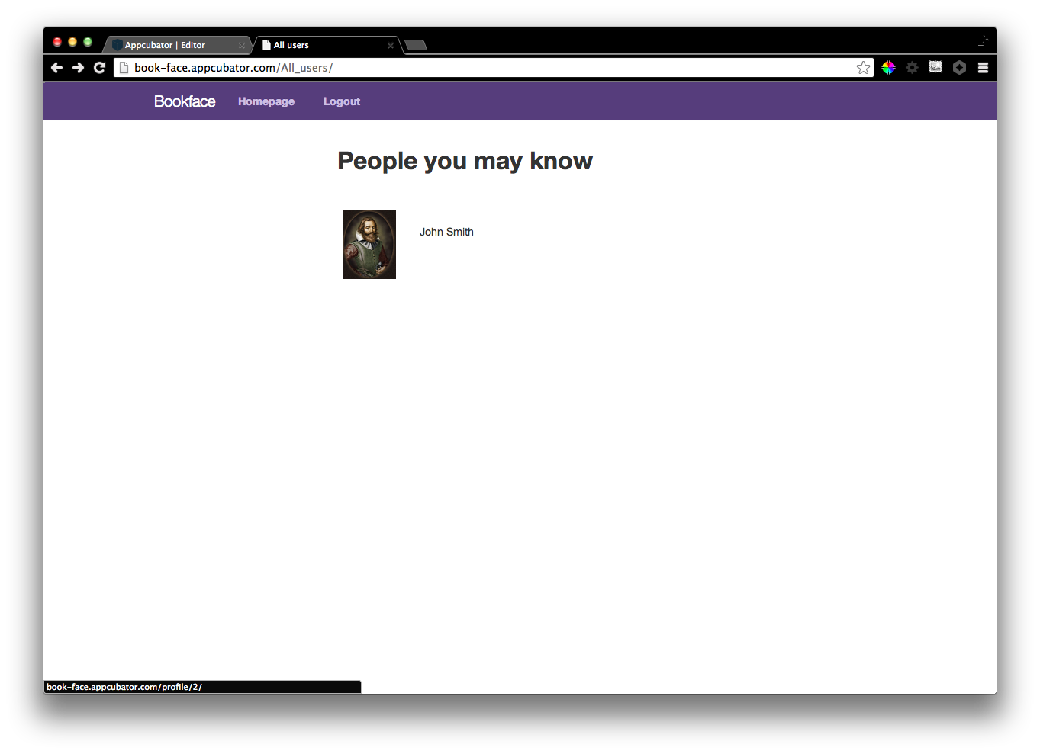
Notes:
Now when you click it, you go to…

Slide 6
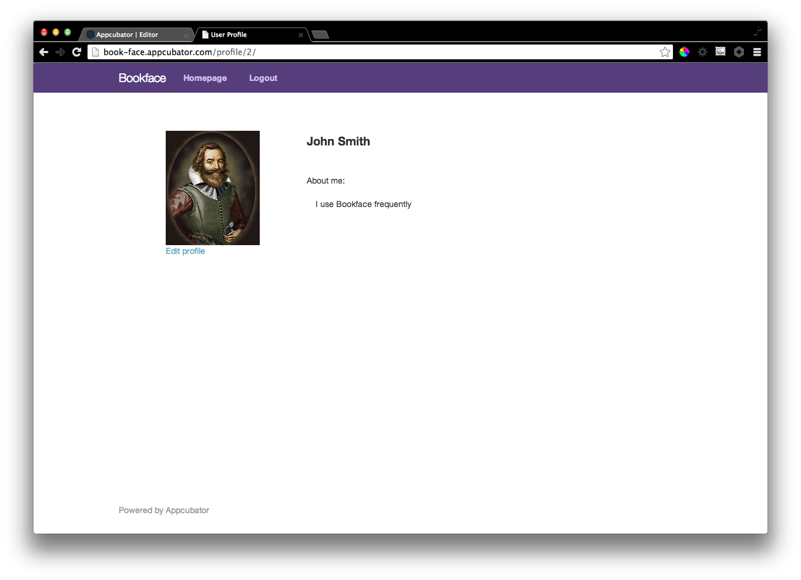
Notes:
The user profile page for that user.

